Slide 1
Module 1: Introduction
What is an operating system?
Simple Batch Systems
Multiprogramming Batched Systems
Time-Sharing Systems
Personal-Computer Systems
Parallel Systems
Distributed Systems
Real -Time Systems

Slide 2
What is an Operating System?
A program that acts as an intermediary between a user of a computer and the computer hardware.
Operating system goals:
  Execute user programs and make solving user problems easier.
  Make the computer system convenient to use.
Use the computer hardware in an efficient manner.

Slide 3
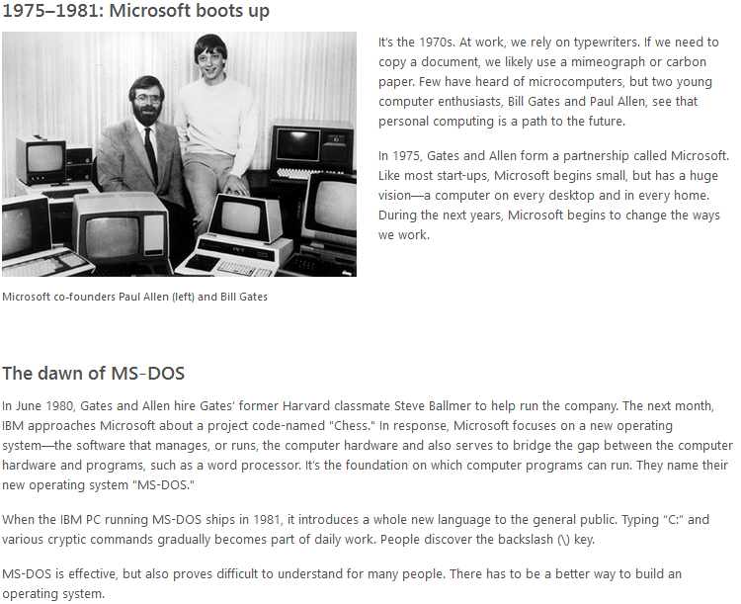
A History of Windows

Slide 4
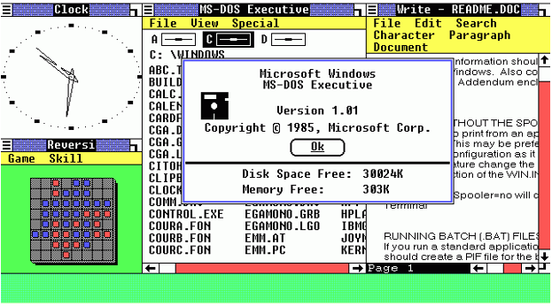
A history of Windows

Slide 5
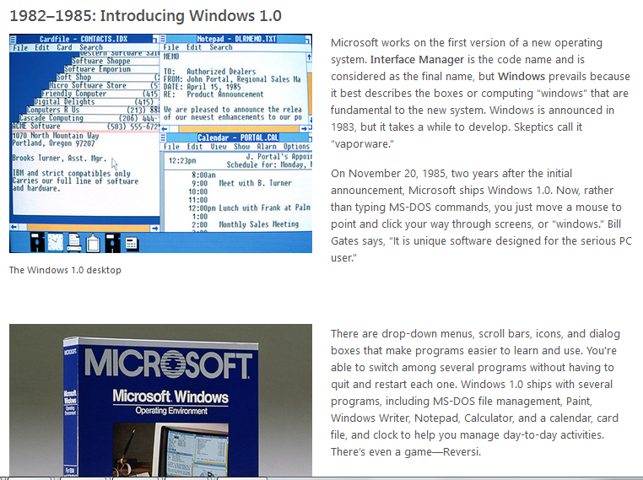
A history of Windows

Slide 6
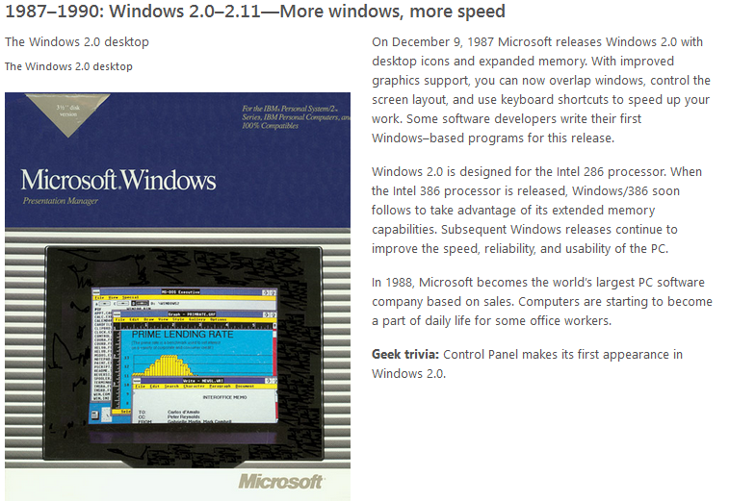
A history of Windows

Slide 7
Computer System Components
1. Hardware – provides basic computing resources (CPU, memory, I/O devices).
2. Operating system – controls and coordinates the use of the hardware among the various application programs for the various users.
3. Applications programs – define the ways in which the system resources are used to solve the computing problems of the users (compilers, database systems, video games, business programs).
4. Users (people, machines, other computers).

Slide 8
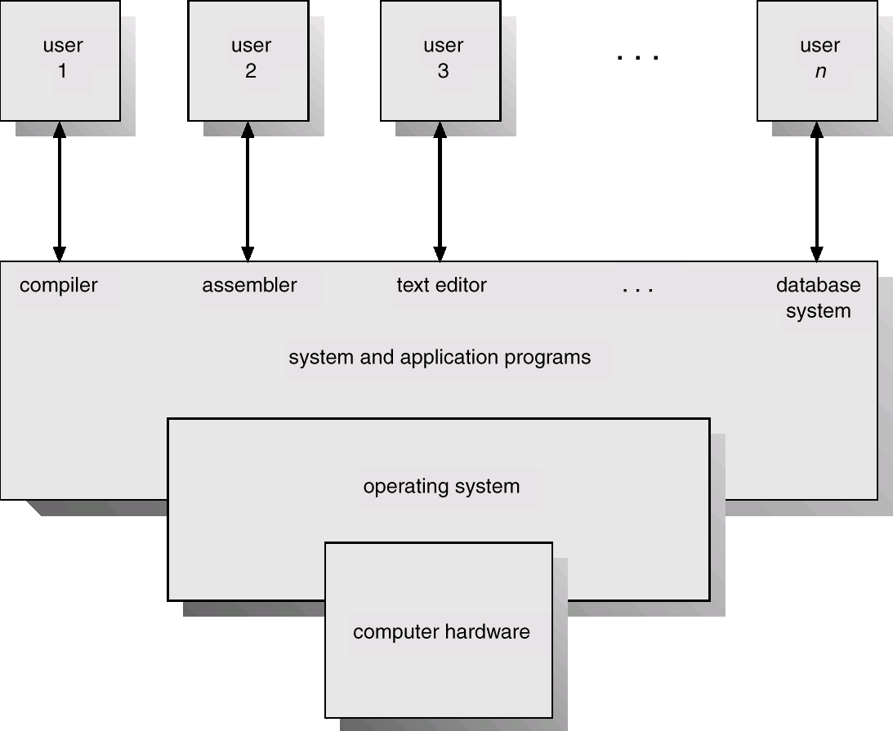
Abstract View of System Components

Slide 9
Operating System Definitions
Resource allocator – manages and allocates resources.
Control program – controls the execution of user programs and operations of I/O devices .
Kernel – the one program running at all times (all else being application programs).

Slide 10
Type of Operating Systems
Batch OS
Multiprorgammed System
Time Sharing System
Personal OS
Multiprocessor OS
Distributed OS
Client –Server OS

Slide 11
Simple Batch Systems
Hire an operator
User ≠ operator
Add a card reader
Reduce setup time by batching similar jobs
Automatic job sequencing – automatically transfers control from one job to another. First rudimentary operating system.
Resident monitor
  initial control in monitor
  control transfers to job
  when job completes control transfers back to monitor

Slide 12
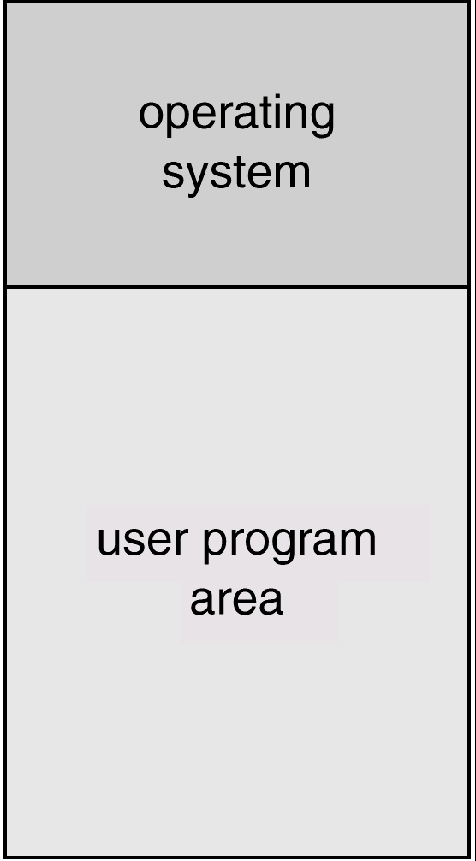
Memory Layout for a Simple Batch System

Slide 13
Control Cards
Problems
  1. How does the monitor know about the nature of the job (e.g., Fortran versus Assembly) or which program to execute?
  2. How does the monitor distinguish
  (a) job from job?
  (b) data from program?
Solution
  Introduce control cards

Slide 14
Control Cards (Cont.)
Special cards that tell the resident monitor which programs to run
$JOB
$FTN
$RUN
$DATA
$END
Special characters distinguish control cards from data or program cards:
$ in column 1
// in column 1 and 2
709 in column1

Slide 15
Control Cards (Cont.)
Parts of resident monitor
  Control card interpreter – responsible for reading and carrying out instructions on the cards.
  Loader – loads systems programs and applications programs into memory.
  Device drivers – know special characteristics and properties for each of the system’s I/O devices.
Problem: Slow Performance – I/O and CPU could not overlap ; card reader very slow.
Solution: Off-line operation – speed up computation by loading jobs into memory from tapes and card reading and line printing done off-line.

Slide 16
Spooling
Overlap I/O of one job with computation of another job. While executing one job, the OS.
  Reads next job from card reader into a storage area on the disk (job queue).
  Outputs printout of previous job from disk to printer.
Job pool – data structure that allows the OS to select which job to run next in order to increase CPU utilization.

Slide 17
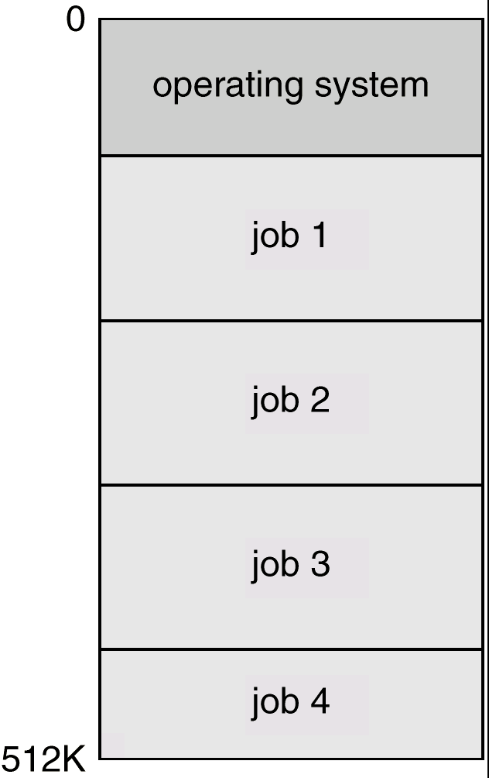
Multiprogrammed Batch Systems
Several jobs are kept in main memory at the same time, and the
CPU is multiplexed among them.

Slide 18
OS Features Needed for Multiprogramming
I/O routine supplied by the system.
Memory management – the system must allocate the memory to several jobs.
CPU scheduling – the system must choose among several jobs ready to run.
Allocation of devices.

Slide 19
Time-Sharing Systems–Interactive Computing
The CPU is multiplexed among several jobs that are kept in memory and on disk (the CPU is allocated to a job only if the job is in memory).
A job is swapped in and out of memory to the disk.
On-line communication between the user and the system is provided; when the operating system finishes the execution of one command, it seeks the next “control statement” not from a card reader, but rather from the user’s keyboard.
On-line system must be available for users to access data

Slide 20
Personal-Computer Systems
Personal computers – computer system dedicated to a single user.
I/O devices – keyboards, mice, display screens, small printers.
User convenience and responsiveness.
Can adopt technology developed for larger operating system’ often individuals have sole use of computer and do not need advanced CPU utilization of protection features.

Slide 21
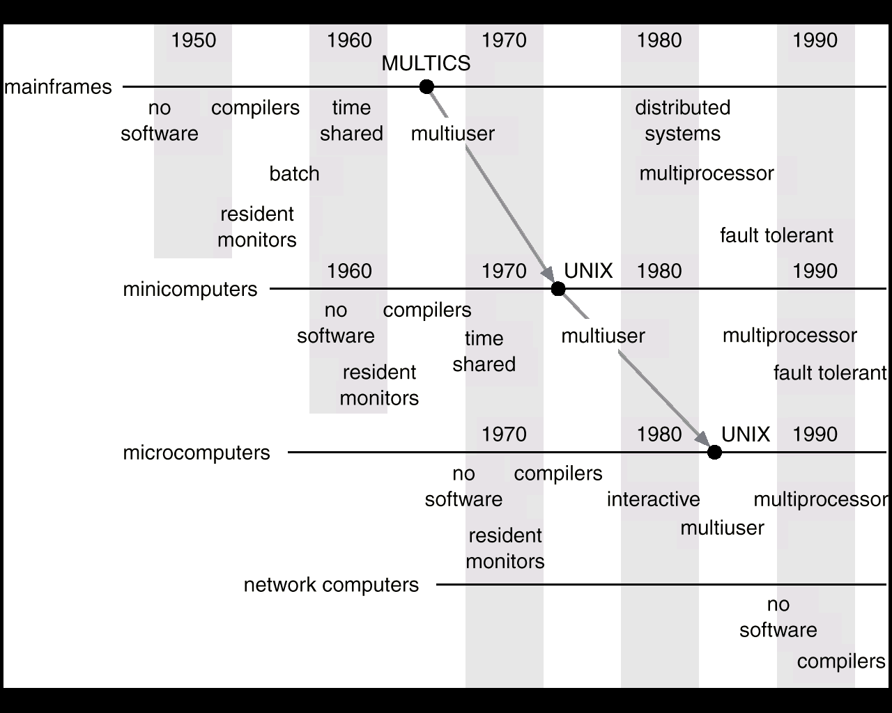
Migration of Operating-System Concepts and Features

Slide 22
Parallel Systems
Multiprocessor systems with more than one CPU in close communication.
Tightly coupled system – processors share memory and a clock; communication usually takes place through the shared memory.
Advantages of parallel system:
  Increased throughput
  Economical
  Increased reliability
    graceful degradation
    fail-soft systems

Slide 23
Parallel Systems (Cont.)
Symmetric multiprocessing (SMP)
  Each processor runs an identical copy of the operating system.
  Many processes can run at once without performance drop.
  Most modern operating systems support SMP
Asymmetric multiprocessing
  Each processor is assigned a specific task; master processor schedules and allocates work to slave processors.
  More common in extremely large systems

Slide 24
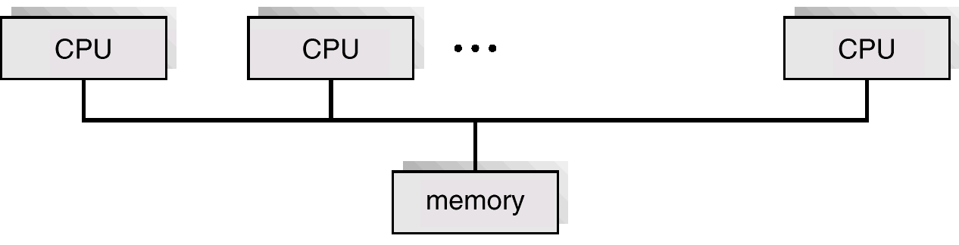
Symmetric Multiprocessing Architecture

Slide 25
Real-Time Systems
Often used as a control device in a dedicated application such as controlling scientific experiments, medical imaging systems, industrial control systems, and some display systems.
Well-defined fixed-time constraints.
Hard real-time system.
  Secondary storage limited or absent, data stored in short-term memory, or read-only memory (ROM)
  Conflicts with time-sharing systems, not supported by general-purpose operating systems.
Soft real-time system
  Limited utility in industrial control or robotics
  Useful in applications (multimedia, virtual reality) requiring advanced operating-system features.

Slide 26
Distributed Systems
Distribute the computation among several physical processors.
Loosely coupled system – each processor has its own local memory; processors communicate with one another through various communications lines, such as high-speed buses or telephone lines.
Advantages of distributed systems.
  Resources Sharing
  Computation speed up – load sharing
  Reliability
  Communications

Slide 27
Distributed Systems (Cont.)
Network Operating System
  provides file sharing
  provides communication scheme
  runs independently from other computers on the network
Distributed Operating System
  less autonomy between computers
  gives the impression there is a single operating system controlling the network.

